Slide 1
Job Market Analysis and Recommendation System
Submitted By :-
Himanshu Sharma

Slide 2
Introduction
The "Job Market Analysis and Recommendation System" project focuses on analyzing real-time job market data to uncover trends, identify high-demand roles, and offer personalized job recommendations. Given the rapidly evolving nature of the job landscape—driven by technology, economics, and cultural shifts—the project aims to provide actionable insights for job seekers and recruiters alike. Through advanced data analytics and machine learning, this system will deliver predictive models, interactive dashboards, and a recommendation engine to support informed career decisions and workforce planning.

Slide 3
The Job Market Analysis and Recommendation System project addresses this need by leveraging real-time and historical job posting data to analyze key trends and build a smart recommendation engine. The goal is to empower users—especially job seekers—with actionable intelligence on high-demand roles, emerging job categories, salary benchmarks, geographic pay variations, and evolving industry needs. By identifying patterns in job titles, salary offers, and posting frequencies, the system aims to provide a comprehensive view of the labor market.

Slide 4
Used libraries
Python (programming language)
SQL (for querying structured data)
Pandas (data manipulation and analysis)
Scikit-learn (machine learning)
TensorFlow (deep learning)
Matplotlib, Seaborn, Plotly (data visualization)
Flask or Django (web development/API)
Docker (containerization and deployment)

Slide 5
Project Overview
The Job Market Analysis and Recommendation System is a comprehensive data-driven project that aims to analyze current and historical job market trends and provide intelligent job recommendations to users. The project is structured to extract valuable insights from real-time job posting data, enabling users to understand employment trends, salary distributions, high-demand roles, and the evolving nature of remote work.
This project is divided into several key tasks, each addressing a critical aspect of job market analysis:

Slide 6
Job Title and Salary Correlation :– Identifies relationships between job title keywords and salary offerings through statistical analysis.
Emerging Job Categories :– Detects new and rapidly growing job fields based on the frequency of job postings.
High-Demand Role Prediction :– Forecasts future in-demand roles using historical posting trends.
Geographic Salary Comparison :– Compares average hourly wages across countries, highlighting regional differences.
Job Recommendation Engine :– Provides personalized job suggestions using real-time data and machine learning models.
Monthly Market Trend Tracker :– Visualizes and updates shifts in the job market over time.

Slide 7
Remote Work Trends Analysis – Investigates how remote work opportunities are changing and becoming more prevalent.
Future Trend Forecasting – Uses predictive analytics to estimate where the job market is headed.

Slide 8
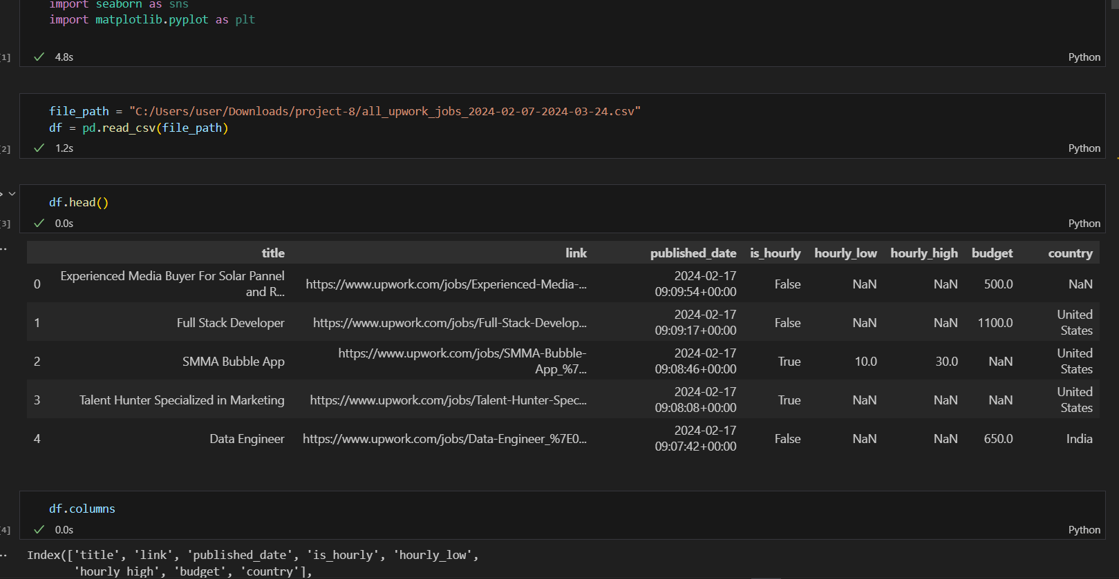

Slide 9
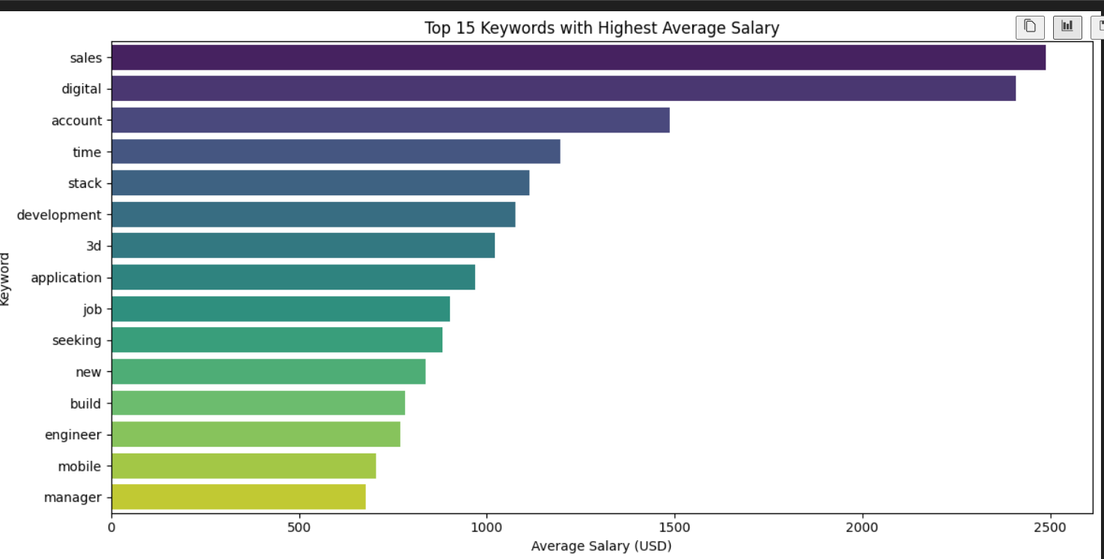
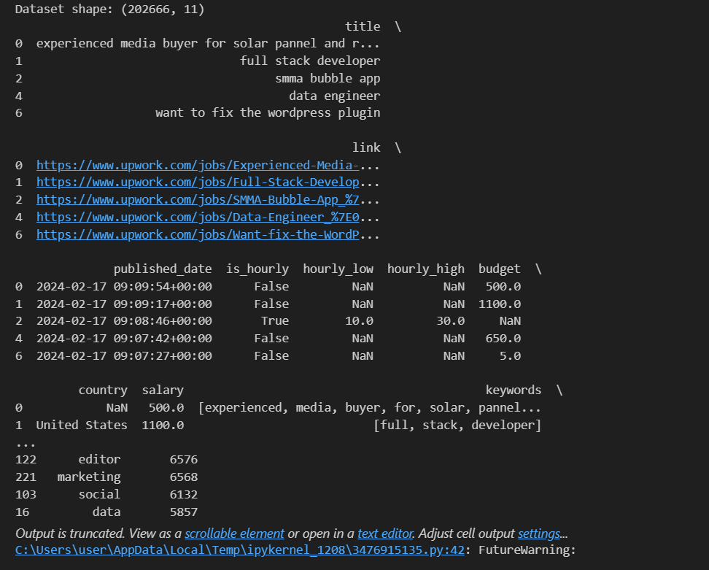

Slide 10
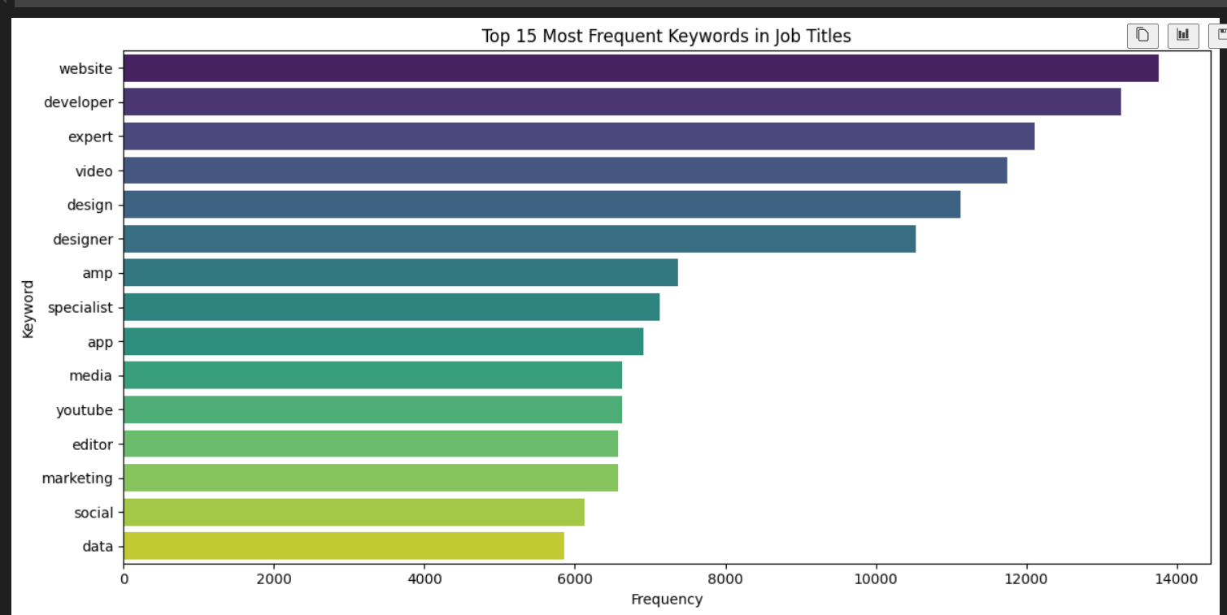
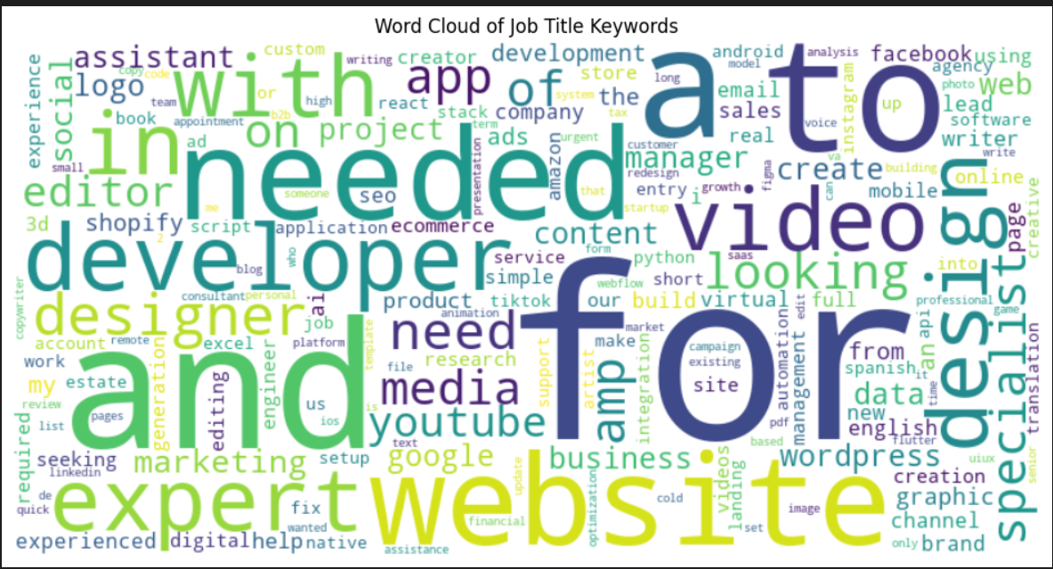

Slide 11
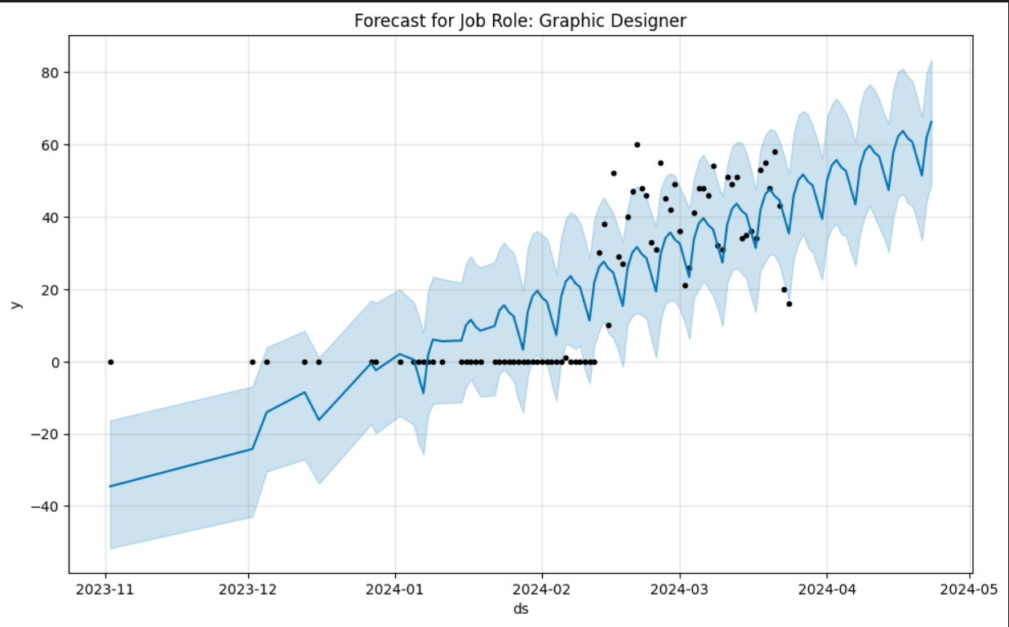
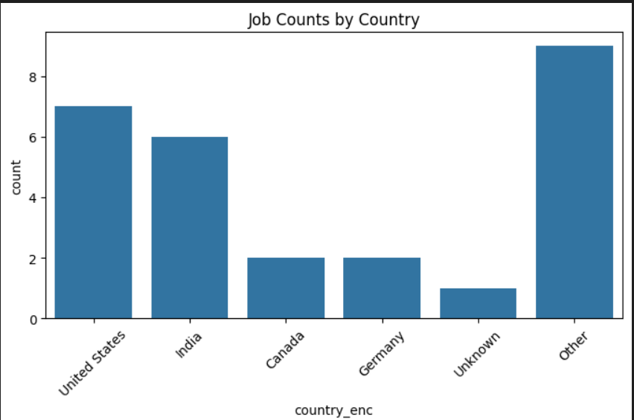

Slide 12
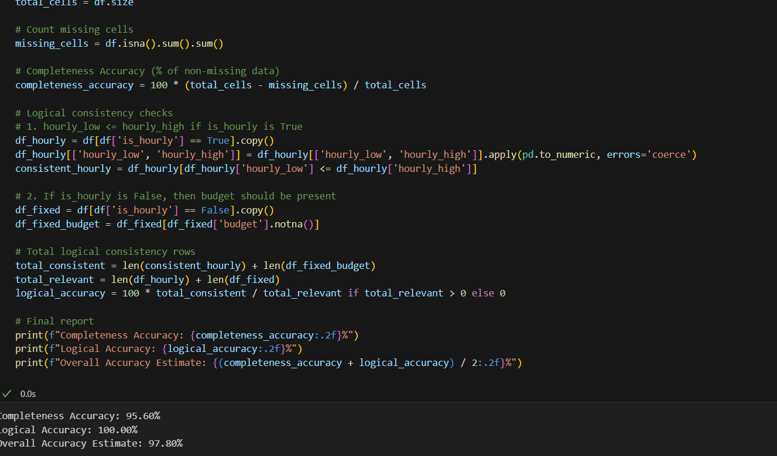

Slide 13
Conclusion
The Job Market Analysis and Recommendation System project represents a comprehensive and data-driven approach to understanding the evolving landscape of employment opportunities and trends. Through the integration of analytical techniques, machine learning models, and web-based technologies, this project successfully delivers a practical solution that not only interprets current market data but also projects future developments. The initiative underscores the importance of data analytics in career planning, recruitment strategies, and policy-making in the modern economy.
Over the course of the project, multiple facets of the job market were examined in depth. We began by exploring the correlation between job title keywords and offered salaries, uncovering patterns that provide valuable insight into how terminology, specialization, and role framing can impact compensation. This information can be especially helpful for job seekers refining their resumes and for recruiters crafting attractive job descriptions.
The project also identified emerging job categories, using job posting frequencies as indicators of market evolution. This analysis highlighted the rise of roles associated with cutting-edge technologies such as artificial intelligence, cybersecurity, and remote collaboration tools—offering a forward-looking perspective that enables proactive career development and hiring.

Slide 14
Another critical achievement was the ability to predict high-demand job roles through time-series analysis and forecasting techniques. By analyzing trends in job postings over time, the system can alert job seekers and employers to opportunities and shifts before they become widespread, giving users a competitive advantage.
In terms of global perspective, the project also succeeded in comparing average hourly rates across countries, providing a meaningful benchmark for job seekers considering remote or international opportunities and for companies establishing global salary structures. An interactive visualization tool was developed to allow users to explore these wage disparities intuitively.
The development of a job recommendation engine was a cornerstone of this project. Built with machine learning algorithms and real-time job data, the engine provides personalized job suggestions tailored to individual user profiles, preferences, and market demand. This system empowers users with actionable guidance, enhancing the efficiency and effectiveness of their job search.
In conclusion, the Job Market Analysis and Recommendation System serves as a vital tool in the digital age, where information and timely decision-making are crucial. It bridges the gap between job market complexity and user accessibility, providing clarity, foresight, and guidance to all stakeholders—from job seekers to recruiters to analysts. This project not only fulfills its immediate objectives but also lays the groundwork for future innovations in employment analytics and personalized career services.

Slide 15
Thank You

